Slide 1
Analyzing Marketing Lift of a Campaign
Establishing an estimated baseline of sales without ads to calculate lift
Rodrigo Rodriguez
7/08/2024
Project B Milestone 4
DSC680 (Summer)
Notes:
Hello everyone, my name is Rodrigo Rodriguez and I’m going to talk about analyzing order history to establish an orders baseline to be used in marketing lift calculations.

Slide 2
Introduction – Business Problem
WM is a large national waste and recycling services provider.
The marketing team has recently launched a new type of marketing campaign and the team is now looking for campaign results
The campaign targets specific zip codes in a local area with the aim of increasing orders in the targeted area.
The success of the campaign will determine if this type of campaign is expanded to other areas.

Slide 3
Solution – Data Science Problem
The business problem becomes can be solved with a time-series ML model.
The approach will be to establish a baseline of what orders in the area would have been without advertising and then compare the baseline estimate with actual orders (exposed to advertising) to calculate lift.
A time-series model can be used to predict what orders without advertising would have been based on historical order volumes in the targeted area.
Since the data is expected to have seasonality, either a SARIMA or Exponential Smoothing model can be implemented.

Slide 4
Data, Variables, and EDA

Slide 5
Data & Variables
Data
Variables
The dataset is sourced from internal WM systems and transformed in a Snowflake SQL environment. The final dataset is a time-series dataset, and the target variable is “IS_ORDER_CONFIRM”
VISIT_START_WEEK – Date
QUALITY_TRAFFIC_TRO – LOB 1 Order Volume
QUALITY_TRAFFIC_OMR – LOB 2 Order Volume
QUALITY_TRAFFIC_SMB – LOB 3 Order Volume
IS_ORDER_CONFIRM – Total Order Volume
Data Source
WM Datawarehouse - Sales History

Slide 6
EDA
Descriptive Statistics
Summary
IS_ORDER_CONFIRM_IND_SUM
count 157.00
mean 22.11
std 8.38
min 9.00
25% 15.00
50% 21.00
75% 27.00
max 47.00
No exogenous variables
Yearly cycle seasonality is present in the data
Mean weekly order volume of 22 with a standard deviation of 8.

Slide 7
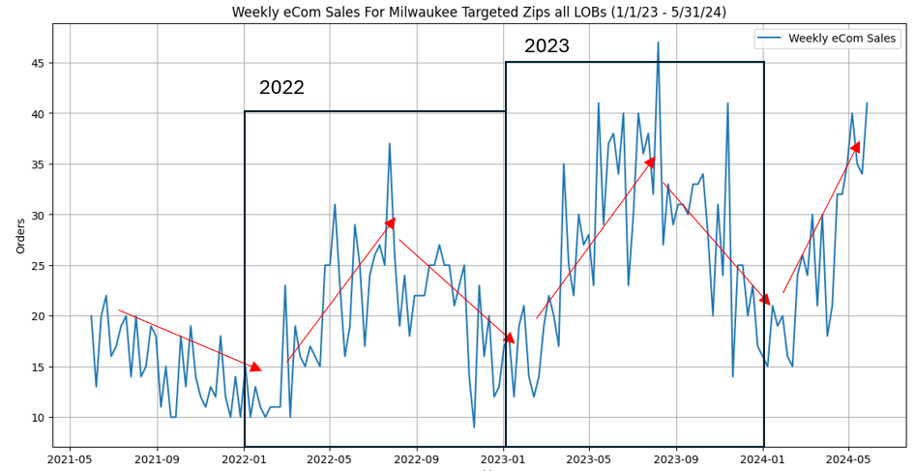
EDA
Time-Series data plotted: Seasonal Cycle Identified

Slide 8
Methodology

Slide 9
Time-Series Data Cleaning / Prep
Time-Series Prep Steps
Purpose
The dataset must be in long format
Change date variable datatypes to datetime.
Set the index of the dataframe to the target date variable.
For this project, aggregated daily records to weekly.
Long format as well as date datatypes enable for time-series plotting and analysis.
Data was aggregated to weekly to reduce noise of daily fluctuations in price.

Slide 10
Modeling Phase
Modeling Phase Steps
Evaluated Models
Training and test splits were split manually by identifying specific dates.
The dates ensured a 90/10 split.
Train and evaluate models
Exponential Smoothing
SARIMA

Slide 11
Evaluation - SARIMA
Performance Metrics
Key Findings
MAE = 25.11
MSE = 4.1
High Mean Average Error and low Mean Square Error indicates a stable model and an expected result. Advertising was present during the test period, so a high MAE is expected.

Slide 12
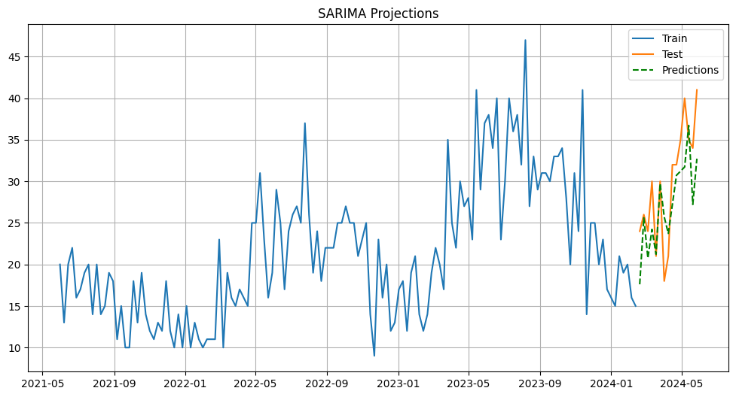
Evaluation - SARIMA

Slide 13
Evaluation –Exponential Smoothing
Performance Metrics
Key Findings
MAE = 4.86
MSE = 27.7
A low Mean Average Error and high Mean Square Error indicate that the model is not as accurate as the SARIMA model. In this specific case, a low MAE is indicating that the Exponential Smoothing model is overestimating orders.

Slide 14
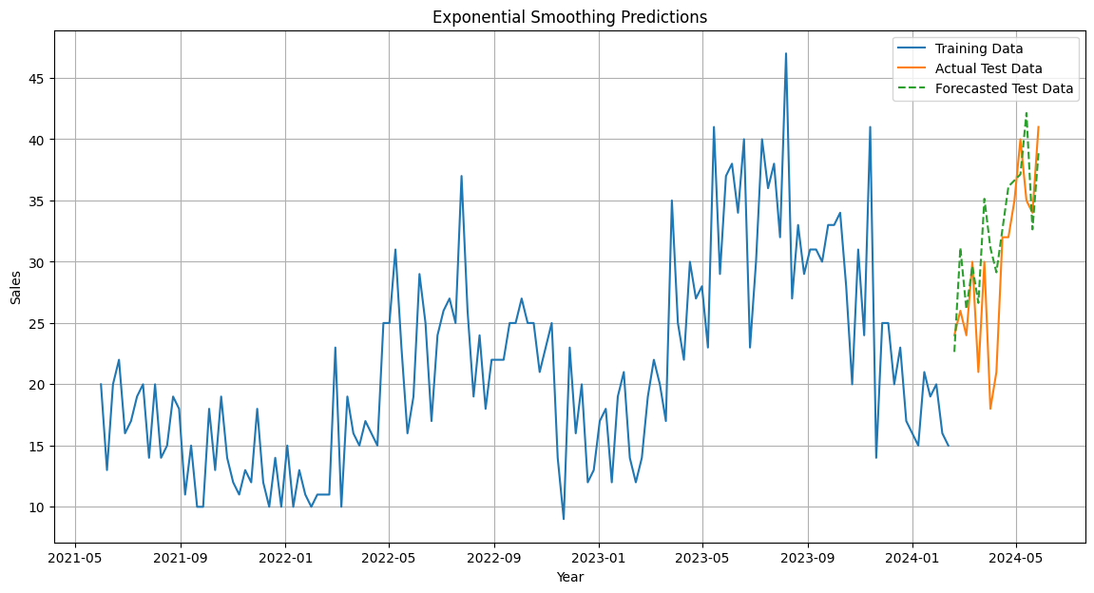
Evaluation – Exponential Smoothing

Slide 15
Conclusion & Recommendation
SARIMA outperformed Exponential Smoothing based on MSE and the contextual information of advertising running during the test period.
Use the SARIMA model to estimate the baseline of orders without advertising.
For future optimizations, introduce exogenous variables related to the marketing campaign and leverage a SARIMAX model.
Ensure that training data is under normal circumstances (no advertising during this period) to better evaluate performance metrics.

Slide 16
Conclusion & Recommendation
Using SARIMA estimated orders as the baseline, the campaign brought in 31 incremental orders during the campaign period.

Slide 17
Sources
Shapiro, G. P., & Masand, B. (1999). Estimating Campaign Benefits and Modeling Lift. KDD99: The First Annual International Conference on Knowledge Discovery in Data, 185-193. https://dl.acm.org/doi/10.1145/312129.312225
Jaffery, T., & Liu, S. X. (2009, March). Measuring campaign performance by using cumulative gain and lift chart. In SAS Global Forum (Vol. 19). https://scsug.org/SCSUGProceedings/2008/papers/app/Tariq_Jaffery_and_Shirle_%20Liu.pdf
Pratt, S., McCabe, S., Cortes-Jimenez, I., & Blake, A. (2010). Measuring the Effectiveness of Destination Marketing Campaigns: Comparative Analysis of Conversion Studies. Journal of Travel Research, 49(2), 179-190. https://doi.org/10.1177/0047287509336471

Slide 18
Thank you
Rodrigo Ivan Rodriguez
7/08/2024
Project B
DSC680 - Summer

